Slide 1
Relational Database Management Checkpoint
By: Olabimitan Daniel Ayomide

Slide 2
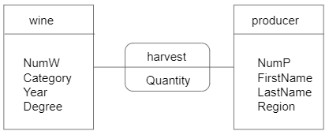
Consider the entity-relationship (conceptual) diagram below;
Convert the entity-relationship (conceptual) diagram above into a Relational model.

Slide 3
Relational model interpretation of the given diagram.
Wine (Wine_id, Category, Year, Degree)
Producer (Producer_id, First_name, Last_name, Region)

